Slide 1
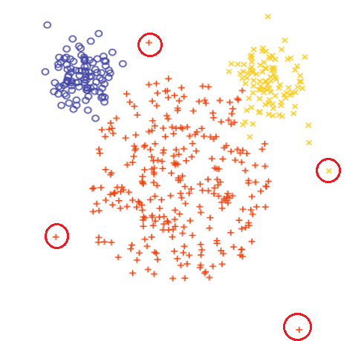
CLUSTERING

Slide 2
Unsupervised learning
Has unlabeled Data.​
There are no correct answers.​
Discovers unknown data patterns and data structure.​

Slide 3
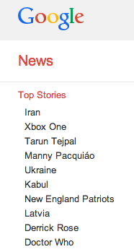

CLUSTERING
The process of grouping a set of objects into classes of similar objects

Slide 4
CLUSTERING
Targeted advertising
Customer segmentation
Image segmentation
Image clustering
Exploratory data analysis

Slide 5
TYPES OF CLUSTERING
Clustering
Hierarchical
Agglomerative
Divisive
Partitional
K-Means
Hierarchical Clustering
Produces a set of nested clusters organized as a hierarchical tree
It can be visualized using a Dendrogram
Partitional Clustering
Data is divided into different partitions hence the name partitional clustering

Slide 6
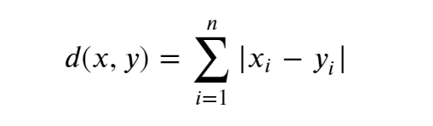
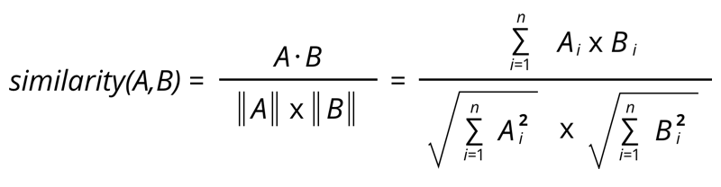
SIMILARITY MEASURES
Euclidian Distance
Manhattan Distance
Cosine Similarity

Slide 7
K MEANS CLUSTERING
Number of clusters, K, must be specified
Each cluster is associated with a centroid (center point)
Each point is assigned to the cluster with the closest centroid
The basic algorithm is very simple
Intra cluster distance is minimized and inter cluster distance is maximized

Slide 8

K MEANS CLUSTERING
START
start with chosen k
How to determine k ?
measure distance / similarity
using appropriate similarity measures
group on basis of similarity
convergence
Acceptance
reposition the centroids
clusters are not stable
clusters are stable

Slide 9
K MEANS CLUSTERING

Slide 10
K MEANS CLUSTERING
Iteration 1

Slide 11
K MEANS CLUSTERING
Iteration 1

Slide 12
K MEANS CLUSTERING
Iteration 2

Slide 13
K MEANS CLUSTERING
Iteration 2

Slide 14
K MEANS CLUSTERING
Iteration 3

Slide 15
K MEANS CLUSTERING
Iteration 3

Slide 16
K MEANS CLUSTERING
Iteration 4

Slide 17
HOW TO CHOOSE K?
The best ways is to know your problem well.
One reliable way is to measure quality of your clusters by using Elbow Method.
Compute clustering algorithm for different values of k. For instance, by varying k from 1 to 10 clusters.
For each k, calculate the total within-cluster sum of squared distance (WSS).
Plot the curve of WSS according to the number of clusters k.
The location of a bend (knee) in the plot is generally considered as an indicator of the appropriate number of clusters.

Slide 18
HOW TO CHOOSE K?
Another way to determine cluster quality is Silhouette Analysis.
It is used to determine the degree of separation between clusters.
Compute clustering algorithm for different values of k. For instance, by varying k from 1 to 10 clusters.
For each k, calculate the average silhouette of observations (avg.sil).
Plot the curve of avg.sil according to the number of clusters k.
The location of the maximum is considered as the appropriate number of clusters.
** Silhouette
Avg distance from all data points in the same cluster (a_{i}).
Avg distance from all data points in the closest cluster (b_{i}).
Compute the coefficient: (b_{i} -a_{i})/max(b_{i},a_{i})

